Slide 1
Local Control Accountability Plan Input
Woodland Joint Unified School District
September 26, 2017

Slide 2
WJUSD Local Control Accountability Plan 2017-20
Supports for Schools and Programs District Goals Equity and Access Gap Analysis and Priorities Instructional Focus Single Plan for Student Achievement | Supports for Students and Families Foster and Homeless Student support 1:1 chromebooks and wireless access Counseling services Family Engagement Parent Project
Notes:
County Office LCAP will be essential two plans- one is for the student programs and the other is to the supports to the Districts that we serve. The input that is being collected today will help inform the SDCOE student programs.

Slide 3
Revisiting the Local Control Funding Formula (LCFF)
Greatly simplifies state funding for local educational agencies (LEAs)
ADJUSTMENTS
$
Grade Level
Per Student Base Amount
Demographics (Low income, English Learner, and/or Foster Youth)
11
Notes:
In California the amount of state funding that goes to support K-14 education depends on the overall size of the state budget. The formula to determine K-14 education’s share of California revenue is Proposition 98, which as a general rule of thumb results in approximately 40% of state revenues going towards K-14 education. The passage of Proposition 30 in 2012 increased state revenue, which helped increase funding for K-14
Education. Another way to think about this is that Proposition 98 determines the size of the K-14 education funding pie. Prior to the passage of the Local Control Funding Formula the state divided the pie into slices for local educational agencies—that includes districts, charter schools, and county offices of education— into two categories revenue limits and categorical programs. In effect, the state told local education agencies through the former funding formula how big their slice was and what the filling would be. Now with the Local Control Funding the state slices the pie based on a relatively simple
calculation, which funds local educational agencies the same amount per student with a handful of adjustments for grade levels and demographic characteristics such as low income students, English learners and foster youth. Also under the Local Control Funding Formula the state has largely handed over responsibility for determining the filling of each pie to local educational agencies. The expectation is that funding flexibility improves the ability of local educational agencies to meet student needs compared to the former system where the state tended to direct funding to specific activities.
The Local Control Funding Formula is a major change to how California has supported local educational agencies. Through the local control funding formula the state is providing new decision making power to local educational agencies to act based on the needs they see for students. In addition, this shifts California from treating funding as an input to support students to a resource that is linked to performance expectations.

Slide 4
Linked To
Notes:
Important Idea is that LCFF links student performance and outcomes to the money. LCAP is that document that shows that link. The Local Control Funding Formula is performance focused. A key provision of the Local Control Funding Formula is that local educational agencies must
have in place Local Control Accountability Plans that clearly show the relationship between state priorities oriented towards student outcomes and
how state funding contributed to student success. The Local Control Funding Formula is student-focused. The Local Control funding Formula places flexibility in the hand of local educational agencies with an expectation of improved outcomes for students across a variety of measures. Student need should drive funding use in a way that fits local contexts.

Slide 5
LCAP Big Ideas
LCAP is a 3-year plan, intended to be an iterative, data-driven and student-centered process
The LCAP is about the goals and what needs to be achieved and the budget is aligned to those goals
Fund that which contributes most to performance
LCAP development is in consultation with stakeholder groups
LCAP will be taken for Board approval in June

Slide 6
What is a service?
Service connotes a category of coordinated/coherent actions that will accomplish its goals of improving student learning.
Service reflects a Theory of Action:
If we provide a personalized learning environment then students will become resilient, accelerate in their learning, and leave college and career ready.
Notes:
CDE, as part of the LCAP process, is recommending defining services within the plan – that is, organizing action steps under some larger concept that supports serving students- not about the doing it’s about the serving. This allows the District to move toward systems thinking and build stronger coherence.
For us, service connotes…. And reflects a Theory of Action.

Slide 7
Services
Equity & Access
Data systems provide real time data
Rigorous curriculum with choice
Supports and Interventions
Capacity Building
Professional Learning for all adults, rooted in student achievement
Time for collaboration and observing instruction
Job-embedded coaching
Developing strengths and exemplars
Personalized Learning
Differentiated Instruction
Behavioral Support
Parent Participation in personalized learning plans and conferences

Slide 8
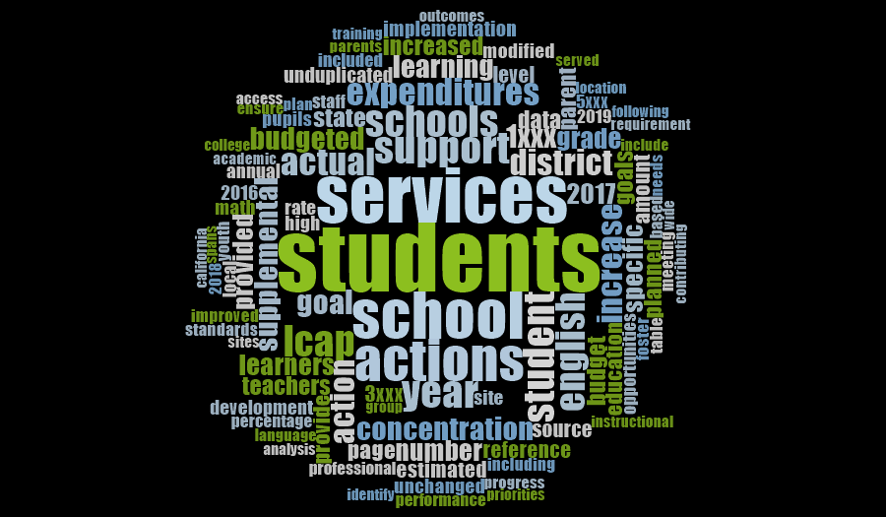
WJUSD LCAP 2017-20
Notes:
The services and the possible strategies that will go in the LCAP should be based on research.

Slide 9
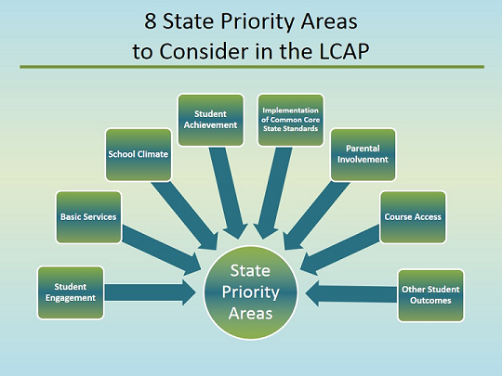
Notes:
The 8 State priority areas must be addressed in each LCAP. For County Offices there are 2 Additional Priorities: Expelled Pupils and Foster Youth
1 Basic Services
2 Implementation of State Standards
3 Parent Involvement
4 Pupil Achievement
5 Pupil Engagement
6 School Climate
7 Course Access
8 Other Pupil Outcomes
9-10 Additional Priorities for County Office of Education: Expelled Pupils & Foster Youth

Slide 10
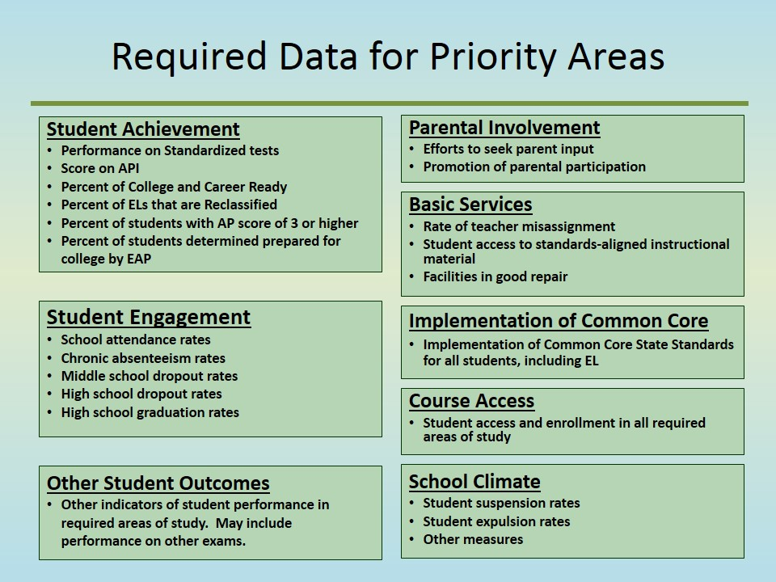
Dashboard
Notes:
The state priorities are expressed as metrics for which the district is expected to develop performance measures to demonstrate how LCFF and the LCAP support student outcomes. The date includes…

Slide 11
Process
Input is collected from staff, students, administrators, parents, and stakeholder groups through surveys and facilitated meetings
LCAP is developed and input is considered in the development of the plan

Slide 12
Data Review Plan
Date of Meeting (WJUSD Board of Trustees) | Goal/Data
September | Goal 1/Local District Assessments
October | Goal 2/ Graduation Rate
November | Goal 3/ Suspension Rate
December | Goal 4/ Reclassification of English Learners
January | Goal 5/ Healthy Kids Survey

Slide 13
Questions?

